Slide 1

PREDICTING HEART ATTACK RISK:
A MACHINE LEARNING APPROACH
Under the supervision of
Dr. Ashutosh Mani
Motilal Nehru National Institute of Technology Allahabad,
Prayagraj
Presented by:
Abhinav Aggarwal 20200003
Ratna Rathaur 20200041
Shivam Pandey 20200049

Slide 2
TABLE OF CONTENTS
INTRODUCTION
LITERATURE REVIEW
RESEARCH GAP
OBJECTIVE
WORK PLAN
METHODOLOGY
RESULTS

Slide 3
INTRODUCTION
Cardiovascular disease
Cardiovascular disease (CVD) is any disease involving the heart or blood vessels. CVDs constitute a class of diseases that includes coronary artery diseases (e.g. angina, heart attack), heart failure, etc.
Heart Attack
A myocardial infarction, commonly known as a heart attack, occurs when blood flow decreases or stops in one of the coronary arteries of the heart causing infarction (tissue death) to the heart muscle.

Slide 4
INTRODUCTION
Epidemiology
Cardiovascular diseases, including heart attacks, remains a significant global health concern. An estimated 17.9 million people died from cardiovascular diseases in 2019, representing 32% of all global deaths. Of these deaths, 85% were due to heart attack and stroke.
Importance of heart attack prediction
Conventional methods of CVD diagnosis are time taking, maybe invasive, are often expensive and sometimes may lead to imprecise diagnosis. Additionally, there maybe a limited availability of medical diagnosing tools and medical experts, specially in undeveloped countries. Early diagnosis and subsequent prevention will prove to be life saving for patients.

Slide 5
LITERATURE REVIEW
TITLE | DESCRIPTION | LINK
Prediction and Diagnosis of Heart Disease by Data Mining Techniques | Data mining techniques were utilized for the prediction of heart disease and J48 outperformed other models like K-Nearest Neighbor (KNN), Support Vector Machines (SVM), and naïve Baye with accuracy of 83%. | https://www.jmest.org/wp-content/uploads/JMESTN42350475.pdf
Prediction of Heart Disease Using Machine Learning Algorithms | Naive Bayes algorithm is analyzed on dataset based on risk factors along with decision trees and combination of algorithms for the prediction of heart disease based on the various attributes, followed by comparison of the two. | https://www.researchgate.net/publication/326733163_Prediction_of_Heart_Disease_Using_Machine_Learning_Algorithms
Heart disease prediction using machine learning algorithms | A prediction system has been declared in this work where logistic regression and KNN have been utilized. An improved accuracy has been shown by the proposed model. | https://iopscience.iop.org/article/10.1088/1757-899X/1022/1/012072
Effective Heart Disease Prediction Using Hybrid Machine Learning Techniques | Worked on different machine learning classifiers to develop HRFLM for the defect prediction in which the maximum accuracy achieved was 88.4% | https://ieeexplore.ieee.org/document/8740989

Slide 6
RESEARCH GAPS
Lack of research on new ML algorithms for prediction
Most of the current literature and research focus on improving old machine learning models using parameter tuning, which can go only so far. New machine learning algorithms allow for more accurate prediction along with improved performance.
Limited use of ML models for early detection
There has been very limited use of ML models by health institutions and doctors due to the absence of a consolidated prediction resource. Existing resources are in their nascent stage, use old ML algorithms or have a proprietary model which limits their use.

Slide 7
OBJECTIVE
Development of an accurate heart attack prediction model
Conventional risk assessment models, while informative, have limitations in their ability to account for the multifaceted nature of heart attack risk.
Machine learning, on the other hand, has the capacity to consider a multitude of risk factors, some of which may be subtle or non-obvious, can identify hidden patterns and thus holds promise in enhancing the accuracy of predictions and facilitating timely interventions

Slide 8
OBJECTIVE
Identification of factors critical in heart attack diagnosis
Identifying important factors in diagnosis is possible through various machine learning techniques like feature selection and feature importance. More focus can be diverted to early diagnosis of these factors medically in a patient which can lead to early detection of the disease.
Creating a resource for prediction of diseases
We aim to expand this prediction to other diseases and leverage the power of machine learning in diagnosis. This can be used by doctors (or even patients) for assessing the health of a patient. An open source resource will also attract more research and adoption.

Slide 9
WORK PLAN
Data Acquisition
Initial data inference and preprocessing
Exploratory Data Analysis (EDA)
Feature Engineering
Training ML models

Slide 10
METHODOLOGY
Data Acquisition
The dataset utilized is composed of four parts or sub-databases i.e., Hungary, Switzerland, Cleveland, and Long Beach which has 76 different attributes. In this work a subset of 11 attributes is utilized because all the published experiments in the literature review referred to these selected 11 attributes which helps to understand the major risk factors of heart disease. This dataset is available online in UCI repository to be availed freely for experimental purpose

Slide 11
METHODOLOGY
Data inference and pre-processing
There are 11 features and 1 target variable.
Data consists of 918 instances.
There were ~230 duplicate values in the dataset. These were removed which shrinked the dataset from down to ~970 instances.
There were some null values in the dataset. These null values has multiple missing values for the entire row, which were then simply removed. This shrinked the dataset to 918 instances.

Slide 12
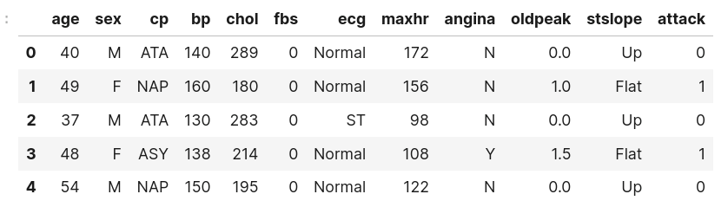
METHODOLOGY
Data Acquisition

Slide 13
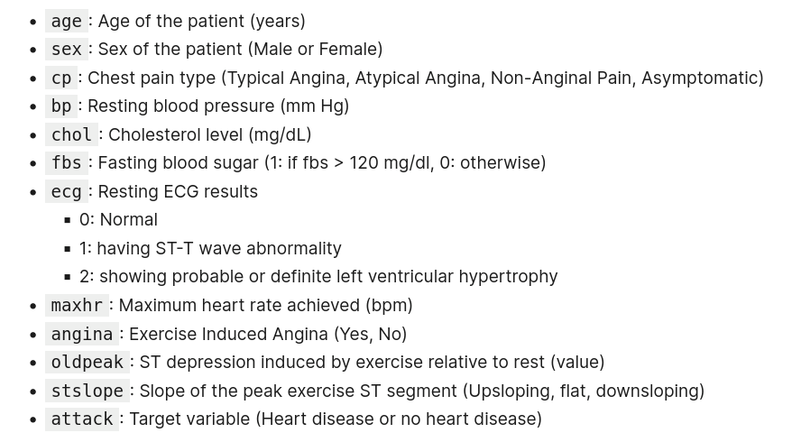
METHODOLOGY
Data inference and pre-processing

Slide 14
METHODOLOGY
Exploratory Data Analysis (EDA)
Extensive Exploratory Data Analysis was performed on the 12 columns of the dataset.
EDA was performed in 3 stages:
Univariate Analysis
Bivariate Analysis
Multivariate Analysis
Various plots were used such as histplot, scatterplot, displot kdeplot to identify relationships between features and target.
Observations were drawn from every plot.

Slide 15
METHODOLOGY
Exploratory Data Analysis (EDA)
Extensive Exploratory Data Analysis was performed on the 12 columns of the dataset.
EDA was performed in 3 stages:
Univariate Analysis
Bivariate Analysis
Multivariate Analysis
Various plots were used such as histplot, scatterplot, displot kdeplot to identify relationships between features and target.
Observations were drawn from every plot.

Slide 16
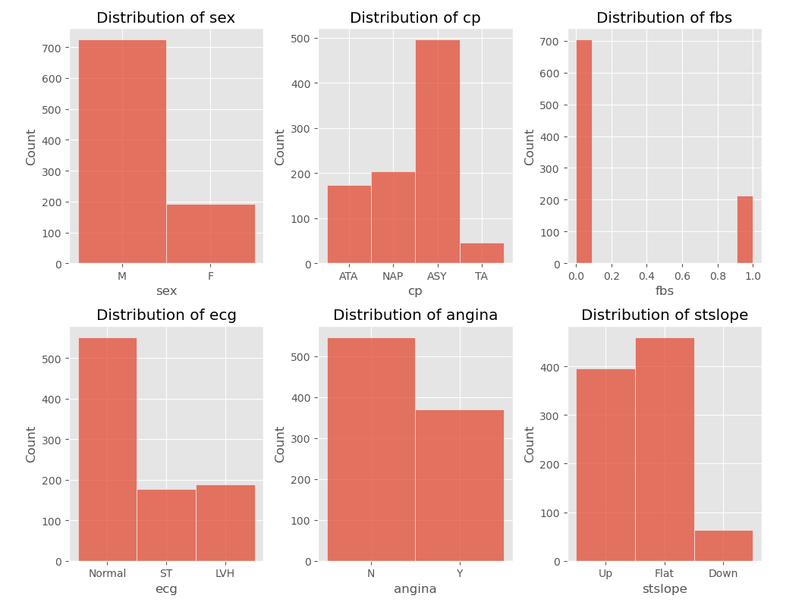

METHODOLOGY
Exploratory
Data
Analysis
Countplot of categorical features for univariate analysis

Slide 17
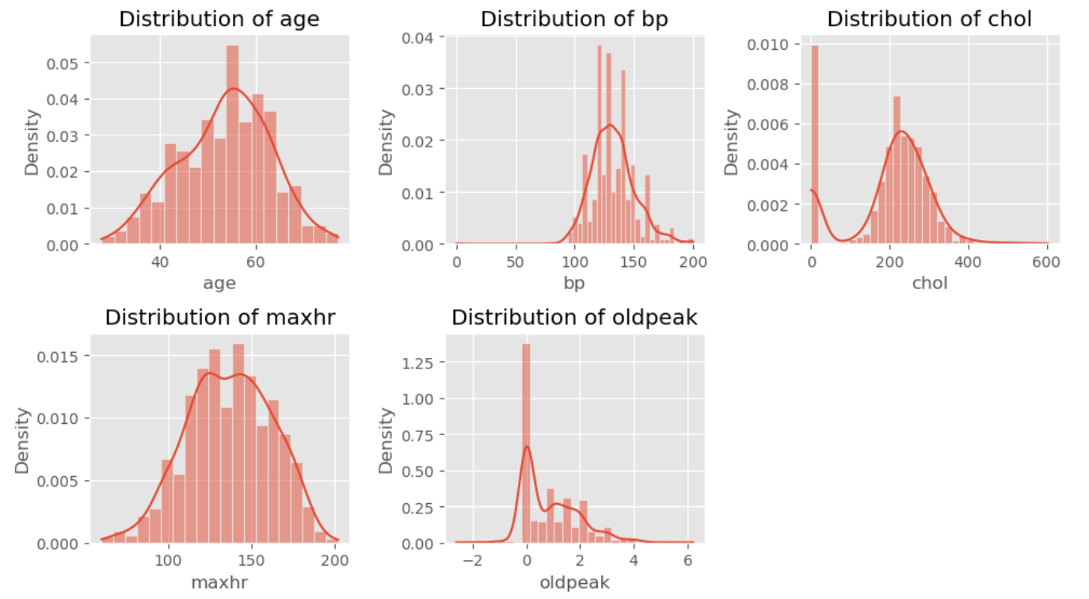

METHODOLOGY
Exploratory
Data
Analysis
Exploratory
Data
Analysis
Countplot of numerical features for univariate analysis

Slide 18
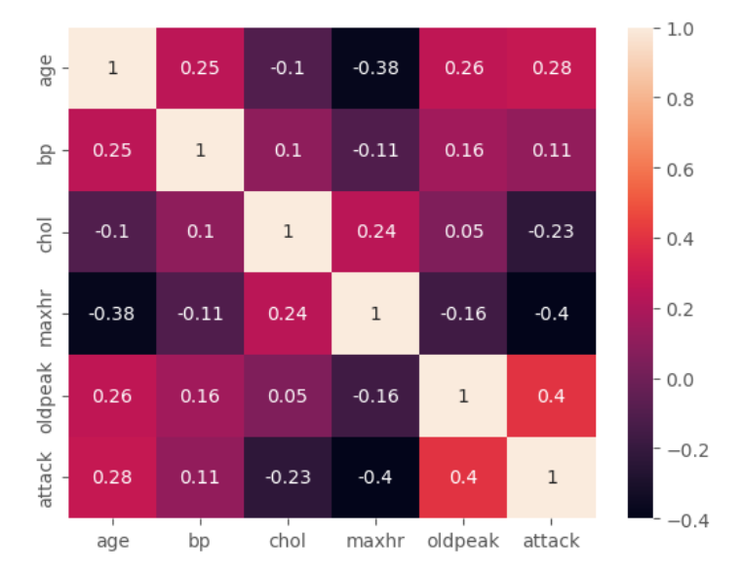
METHODOLOGY
Feature Engineering
Data scaling was performed using MinMaxScaler() as the features did not have a Normal distribution.
Correlation matrix was plotted to identify correlation between variables and to identify any problem of multicollinearity.

Slide 19
METHODOLOGY
Train ML models
Following ML models were trained:
K-nearest Neighbour classifier (KNN)
Logistic Regression
Support Vector Machine (SVM)
Decision trees
Random Forest
Gradient Boost
Scikit-learn implementation of these models were used for training.

Slide 20
METHODOLOGY
Train ML models
Algorithm | Accuracy | “At risk” Recall
KNN | 84% | 87%
Logistic Regression | 88% | 92%
Support Vector Machine | 89% | 91%
Decision Tree | 73% | 76%
Random Forest | 90% | 93%
Gradient Boost | 92% | 93%

Slide 21
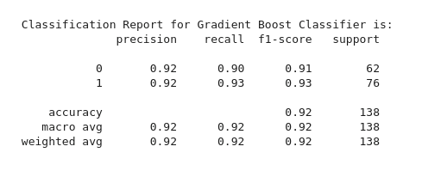
RESULTS
Gradient Boost was the best performing model.
The accuracy of Gradient Boost was the highest of all models at 92%.
The most important criterion for disease prediction, the “at risk” recall was 93%.

Slide 22
FUTURE DIRECTION
FEATURE SCALING
Implementing feature scaling to choose the most important features for prediction. These features will then be feeded into the ML model which can result in potential increase in the performance of the mode to give more accurate results.
FEATURE IMPORTANCE
Using algorithms like Random Forest, we can calculate the feature importance of various attributes. These features can then be used for early medical diagnosis of the disease.
EXPANSION TO OTHER DISEASES
Similar prediction models will be developed for other diseases and this can be used to create an open-source prediction resource for further research and eventual mainstream usage by medical institutions.

Slide 23
THANK YOU

